Slide 1
New attack on LEDAcrypt
Daniel Apon¹, Corbin McNeill², Ray Perlner¹, Angela Robinson¹
^{1: NIST}
^{2: UMD}

Slide 2
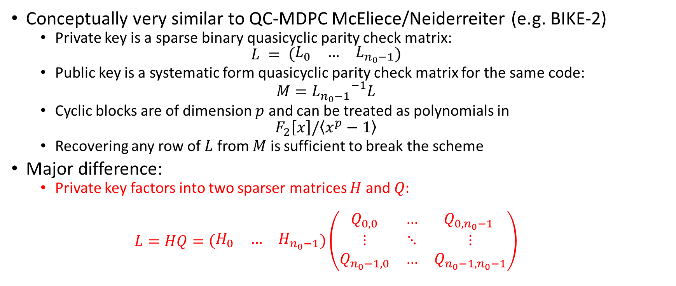
LEDAcrypt Overview
Conceptually very similar to QC-MDPC McEliece/Neiderreiter (e.g. BIKE-2)
  Private key is a sparse binary quasicyclic parity check matrix:
  $$L = \left(\begin{matrix}L_{0} & … & L_{n_{0}−1}\end{matrix}\right)$$
  Public key is a systematic form quasicyclic parity check matrix for the same code:
  $$M={L_{n_{0}−1}}^{−1}L$$
  Cyclic blocks are of dimension $p$ and can be treated as polynomials in
  $$F_{2}\left[x\right]/\left\langle x^{p}−1\right\rangle$$
  Recovering any row of $L$ from $M$ is sufficient to break the scheme
Major difference:
  Private key factors into two sparser matrices $H$ and $Q:$
  $$L=HQ=\left(\begin{matrix}H_{0} & … & H_{n_{0}−1}\end{matrix}\right)\left(\begin{matrix}Q_{0,0} & … & Q_{0,n_{0}−1} \\ ⋮ & ⋱ & ⋮ \\ Q_{n_{0}−1,0} & … & Q_{n_{0}−1,n_{0}−1}\end{matrix}\right)$$

Slide 3
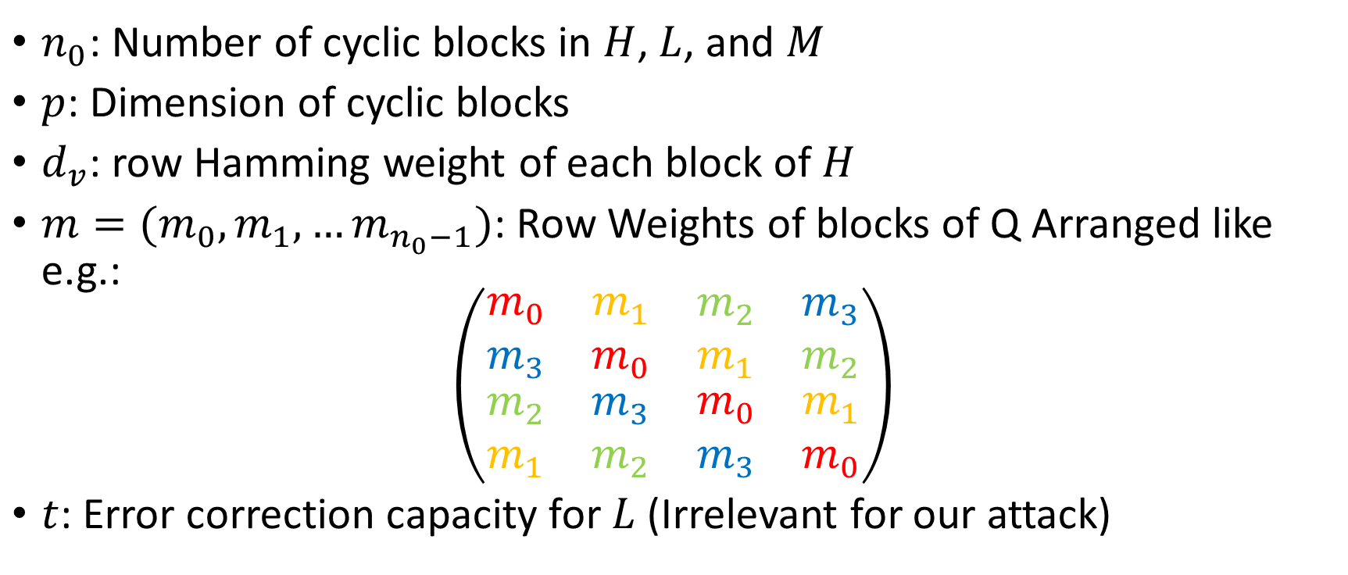
LEDAcrypt Parameters
$n_{0}$: Number of cyclic blocks in $H$, $L$, and $M$
$p$: Dimension of cyclic blocks
$d_{v}$: row Hamming weight of each block of $H$
$m=(m_{0},m_{1},…m_{n_{0}−1})$: Row Weights of blocks of Q Arranged like e.g.:
$$\left(\begin{matrix}\begin{matrix}m_{0} & m_{1} \\ m_{3} & m_{0}\end{matrix} & \begin{matrix}m_{2} & m_{3} \\ m_{1} & m_{2}\end{matrix} \\ \begin{matrix}m_{2} & m_{3} \\ m_{1} & m_{2}\end{matrix} & \begin{matrix}m_{0} & m_{1} \\ m_{3} & m_{0}\end{matrix}\end{matrix}\right)$$
$t$: Error correction capacity for $L$ (Irrelevant for our attack)

Slide 4
LEDAcrypt parameters (CPA)

Slide 5
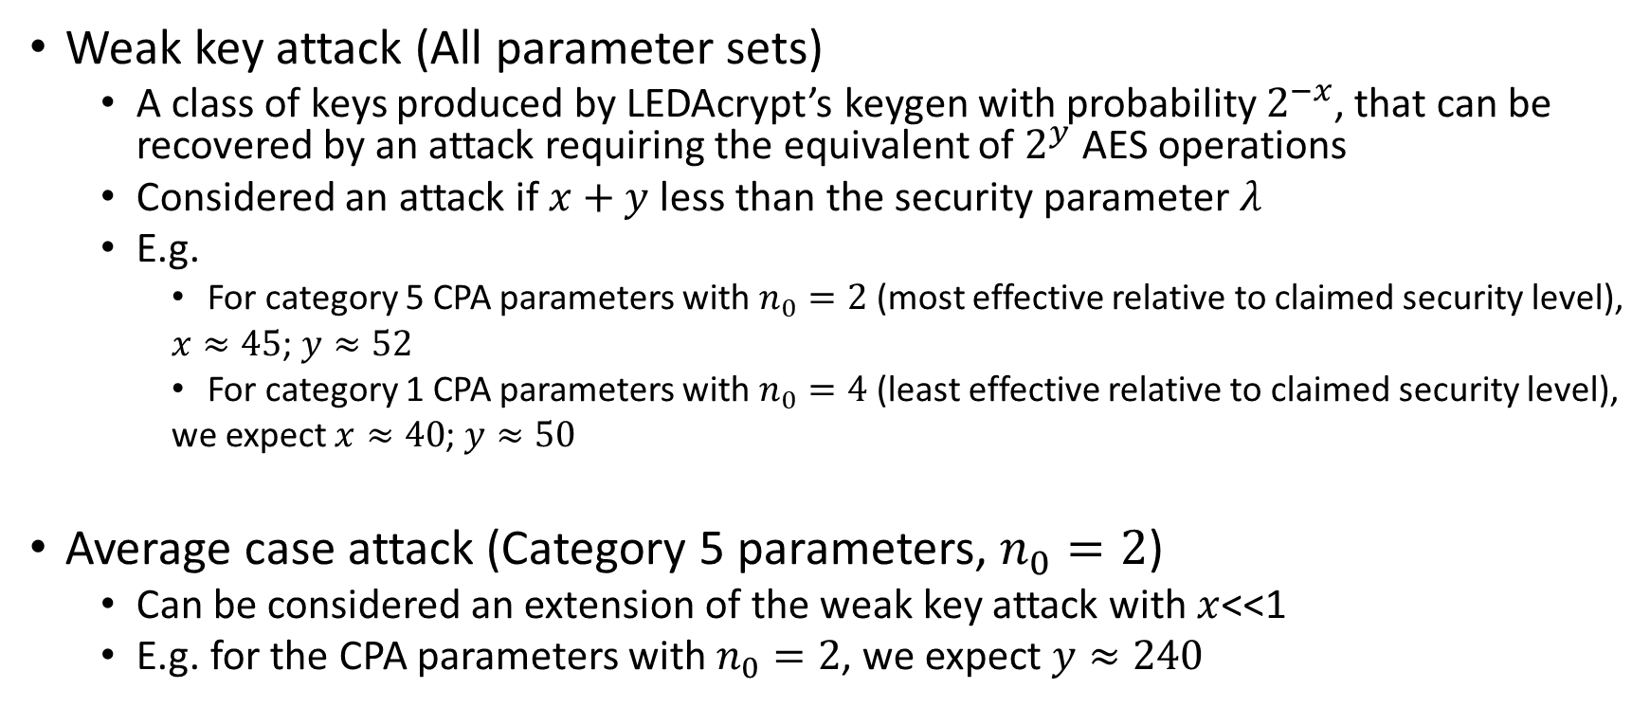
Summary of attacks
Weak key attack (All parameter sets)
  A class of keys produced by LEDAcrypt’s keygen with probability $2^{−x}$, that can be recovered by an attack requiring the equivalent of $2^{y}$ AES operations
  Considered an attack if $x+y$ less than the security parameter $λ$
  E.g.
    For category 5 CPA parameters with $n_{0}=2$ (most effective relative to claimed security level),
    $x≈45$; $y≈52$
    For category 1 CPA parameters with $n_{0}=4$ (least effective relative to claimed security level),
    we expect $x≈40$; $y≈50$
Average case attack (Category 5 parameters, $n_{0}=2$)
  Can be considered an extension of the weak key attack with $x$<<1
  E.g. for the CPA parameters with $n_{0}=2$, we expect $y≈240$

Slide 6
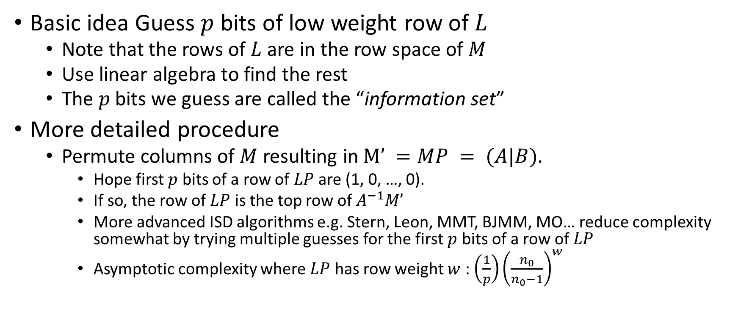
Key recovery for MDPC codes
Information Set Decoding
Basic idea Guess $p$ bits of low weight row of $L$
  Note that the rows of $L$ are in the row space of $M$
  Use linear algebra to find the rest
  The $p$ bits we guess are called the “information set”
More detailed procedure
  Permute columns of $M$ resulting in $M’ =MP = (A|B).$
    Hope first $p$ bits of a row of $LP$ are (1, 0, …, 0).
    If so, the row of $LP$ is the top row of $A^{−1}M’$
    More advanced ISD algorithms e.g. Stern, Leon, MMT, BJMM, MO… reduce complexity somewhat by trying multiple guesses for the first $p$ bits of a row of $LP$
    Asymptotic complexity where $LP$ has row weight $w$ : ${\left(\frac{1}{p}\right)\left(\frac{n_{0}}{n_{0}−1}\right)}^{w}$

Slide 7
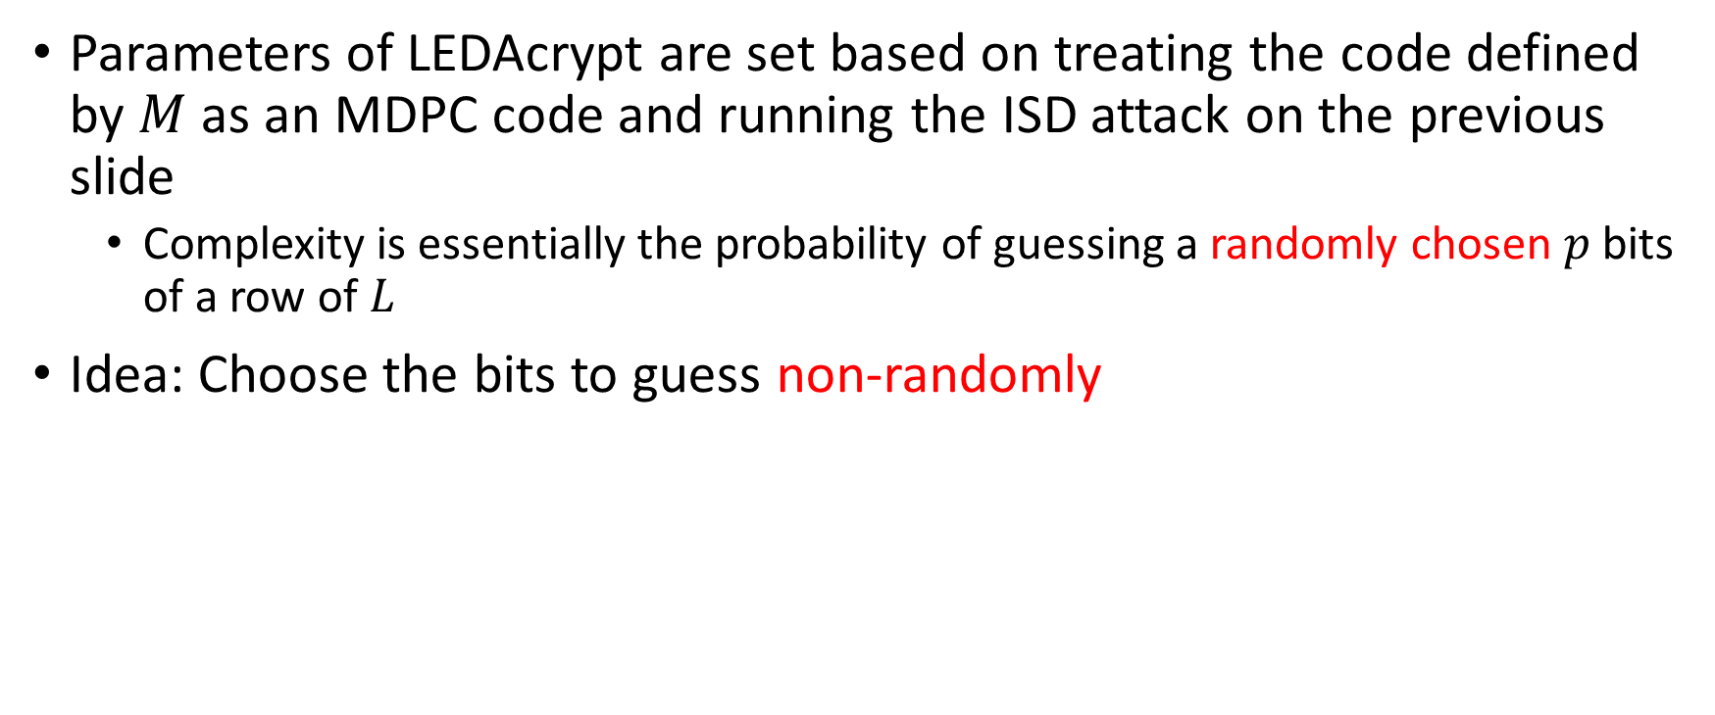
Using LEDAcrypt’s Product Structure
Basic Idea
Parameters of LEDAcrypt are set based on treating the code defined by $M$ as an MDPC code and running the ISD attack on the previous slide
  Complexity is essentially the probability of guessing a randomly chosen $p$ bits of a row of $L$
Idea: Choose the bits to guess non-randomly

Slide 8
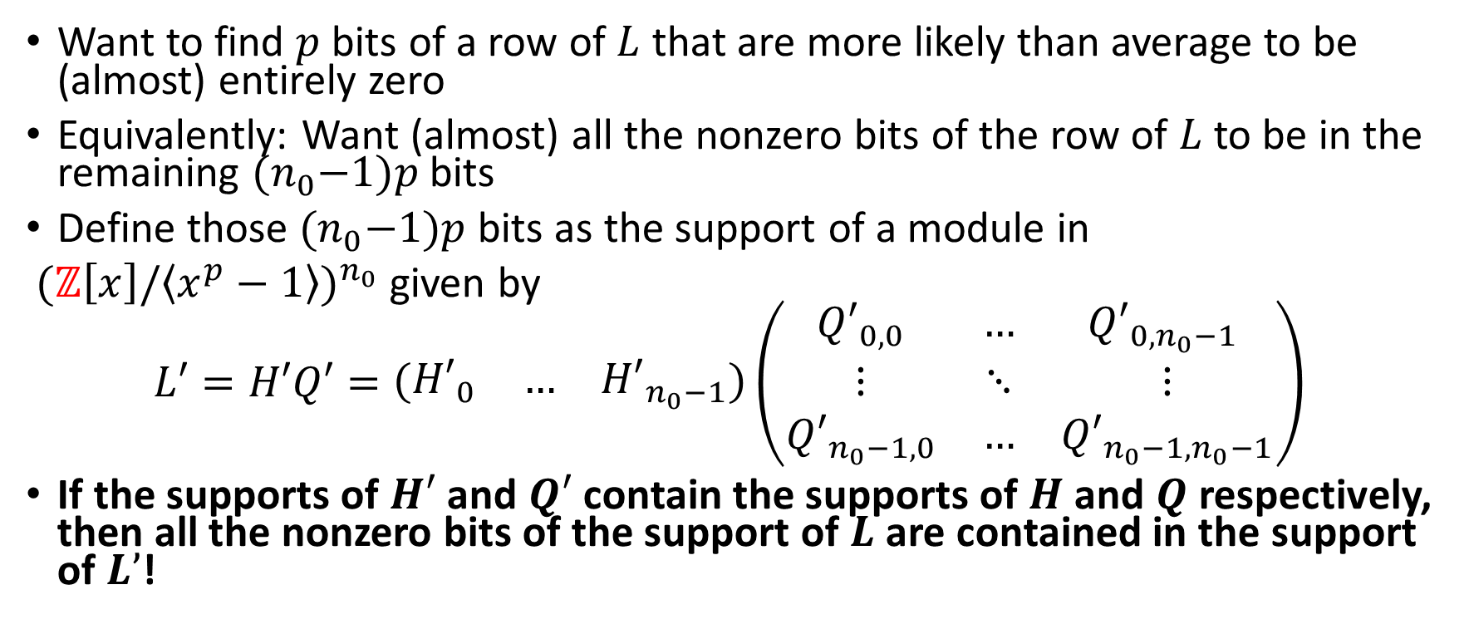
Using LEDAcrypt’s Product Structure
Choosing the bits to Guess
Want to find $p$ bits of a row of $L$ that are more likely than average to be (almost) entirely zero
Equivalently: Want (almost) all the nonzero bits of the row of $L$ to be in the remaining ${(n}_{0}−1)p$ bits
Define those ${(n}_{0}−1)p$ bits as the support of a module in
${(ℤ\left[x\right]/\left\langle x^{p}−1\right\rangle )}^{n_{0}}$ given by
$$L′=H′Q′=\left(\begin{matrix}{H′}_{0} & … & {H′}_{n_{0}−1}\end{matrix}\right)\left(\begin{matrix}{Q′}_{0,0} & … & {Q′}_{0,n_{0}−1} \\ ⋮ & ⋱ & ⋮ \\ {Q′}_{n_{0}−1,0} & … & {Q′}_{n_{0}−1,n_{0}−1}\end{matrix}\right)$$
If the supports of $H′$ and $Q′$ contain the supports of $H$ and $Q$ respectively, then all the nonzero bits of the support of $L$ are contained in the support of $L’$!

Slide 9
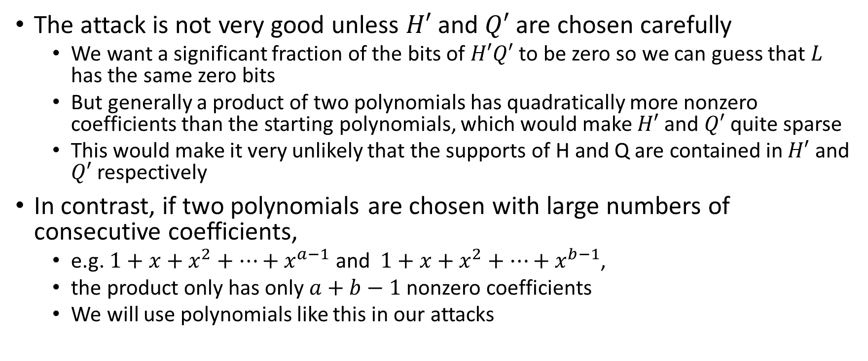
Contiguous nonzero coefficients
The attack is not very good unless $H′$ and $Q′$ are chosen carefully
  We want a significant fraction of the bits of $H′Q′$ to be zero so we can guess that $L$ has the same zero bits
  But generally a product of two polynomials has quadratically more nonzero coefficients than the starting polynomials, which would make $H′$ and $Q′$ quite sparse
  This would make it very unlikely that the supports of H and Q are contained in $H′$ and $Q′$ respectively
In contrast, if two polynomials are chosen with large numbers of consecutive coefficients,
  e.g. $1+x+x^{2}+…+x^{a−1}$ and $1+x+x^{2}+…+x^{b−1}$,
  the product only has only $a+b−1$ nonzero coefficients
  We will use polynomials like this in our attacks

Slide 10
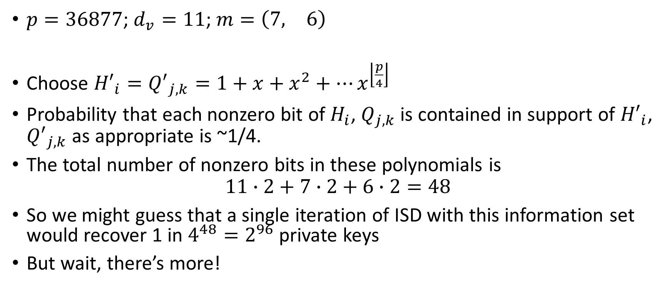
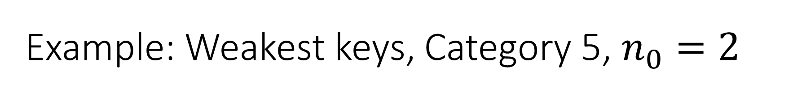
Example: Weakest keys, Category 5, $n_{0}=2$
$p=36877$; $d_{v}=11$; $m=\left(\begin{matrix}7, & 6\end{matrix}\right)$
Choose ${H′}_{i}={Q′}_{j,k}=1+x+x^{2}+…x^{\left\lfloor \frac{p}{4}\right\rfloor }$
Probability that each nonzero bit of $H_{i}$, $Q_{j,k}$ is contained in support of ${H′}_{i}$, ${Q′}_{j,k}$ as appropriate is ~1/4.
The total number of nonzero bits in these polynomials is
$$11∙2+7∙2+6∙2=48$$
So we might guess that a single iteration of ISD with this information set would recover 1 in $4^{48}=2^{96}$ private keys
But wait, there’s more!

Slide 11
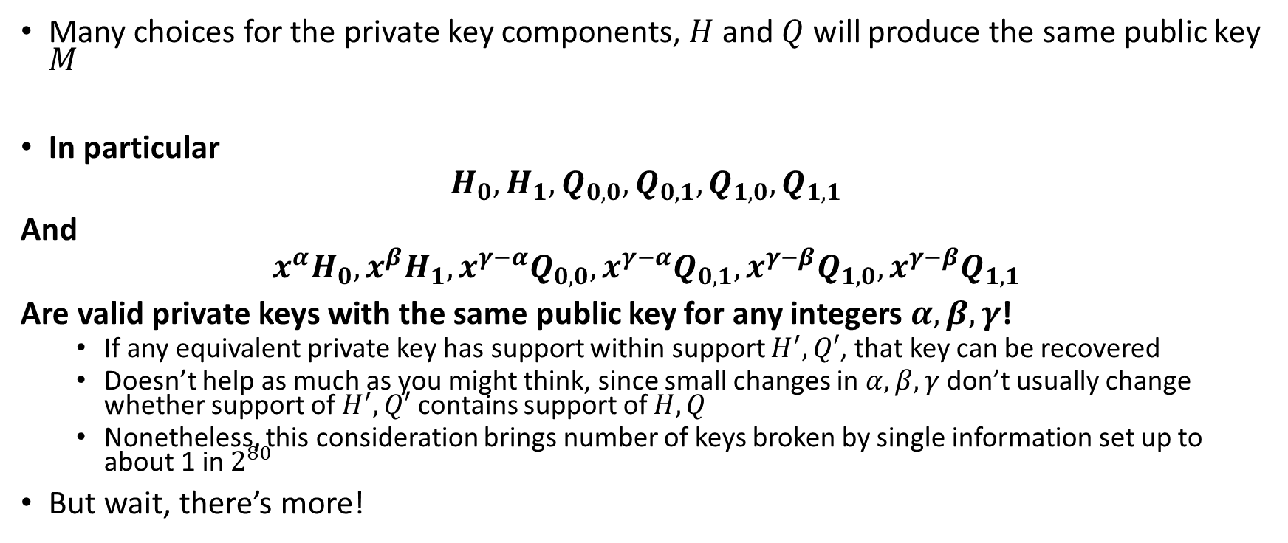
Equivalent keys
Many choices for the private key components, $H$ and $Q$ will produce the same public key $M$
In particular
$$H_{0},H_{1},Q_{0,0},Q_{0,1},Q_{1,0},Q_{1,1}$$
And
$${x^{α}H}_{0},{x^{β}H}_{1},x^{γ−α}Q_{0,0},{x^{γ−α}Q}_{0,1},{x^{γ−β}Q}_{1,0},{x^{γ−β}Q}_{1,1}$$
Are valid private keys with the same public key for any integers $α,β,γ$!
  If any equivalent private key has support within support $H^{′},Q′$, that key can be recovered
  Doesn’t help as much as you might think, since small changes in $α,β,γ$ don’t usually change whether support of $H^{′},Q′$ contains support of $H,Q$
  Nonetheless, this consideration brings number of keys broken by single information set up to about 1 in $2^{80}$
But wait, there’s more!

Slide 12
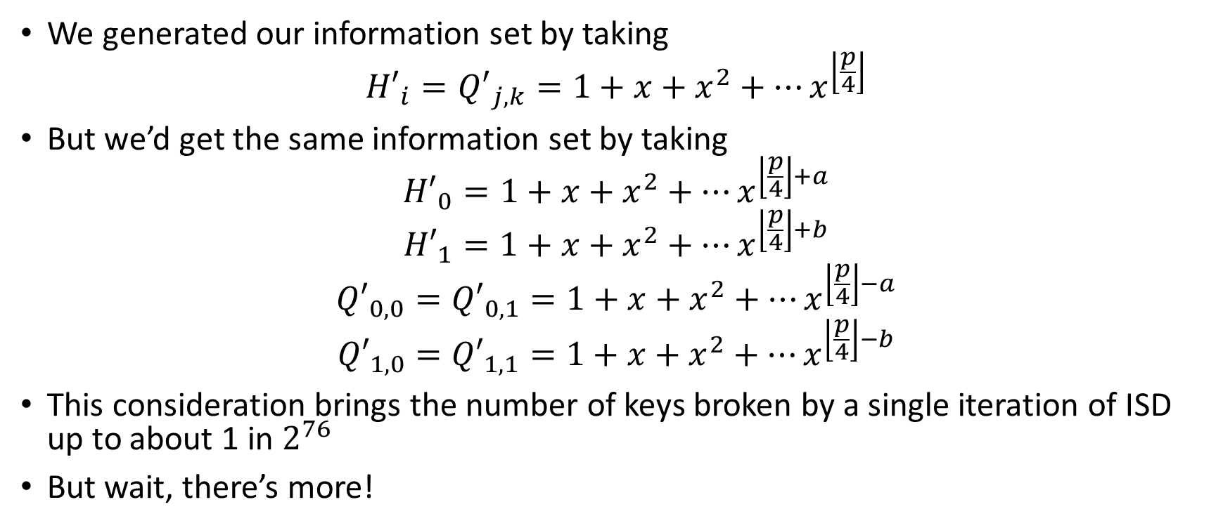

Equivalent choices of $H^{′}$ and $Q′$
We generated our information set by taking
$${H′}_{i}={Q′}_{j,k}=1+x+x^{2}+…x^{\left\lfloor \frac{p}{4}\right\rfloor }$$
But we’d get the same information set by taking
$${H′}_{0}=1+x+x^{2}+…x^{\left\lfloor \frac{p}{4}\right\rfloor +a}$$
$${H′}_{1}=1+x+x^{2}+…x^{\left\lfloor \frac{p}{4}\right\rfloor +b}$$
$${Q′}_{0,0}={Q′}_{0,1}=1+x+x^{2}+…x^{\left\lfloor \frac{p}{4}\right\rfloor −a}$$
$${Q′}_{1,0}={Q′}_{1,1}=1+x+x^{2}+…x^{\left\lfloor \frac{p}{4}\right\rfloor −b}$$
This consideration brings the number of keys broken by a single iteration of ISD up to about 1 in $2^{76}$
But wait, there’s more!

Slide 13
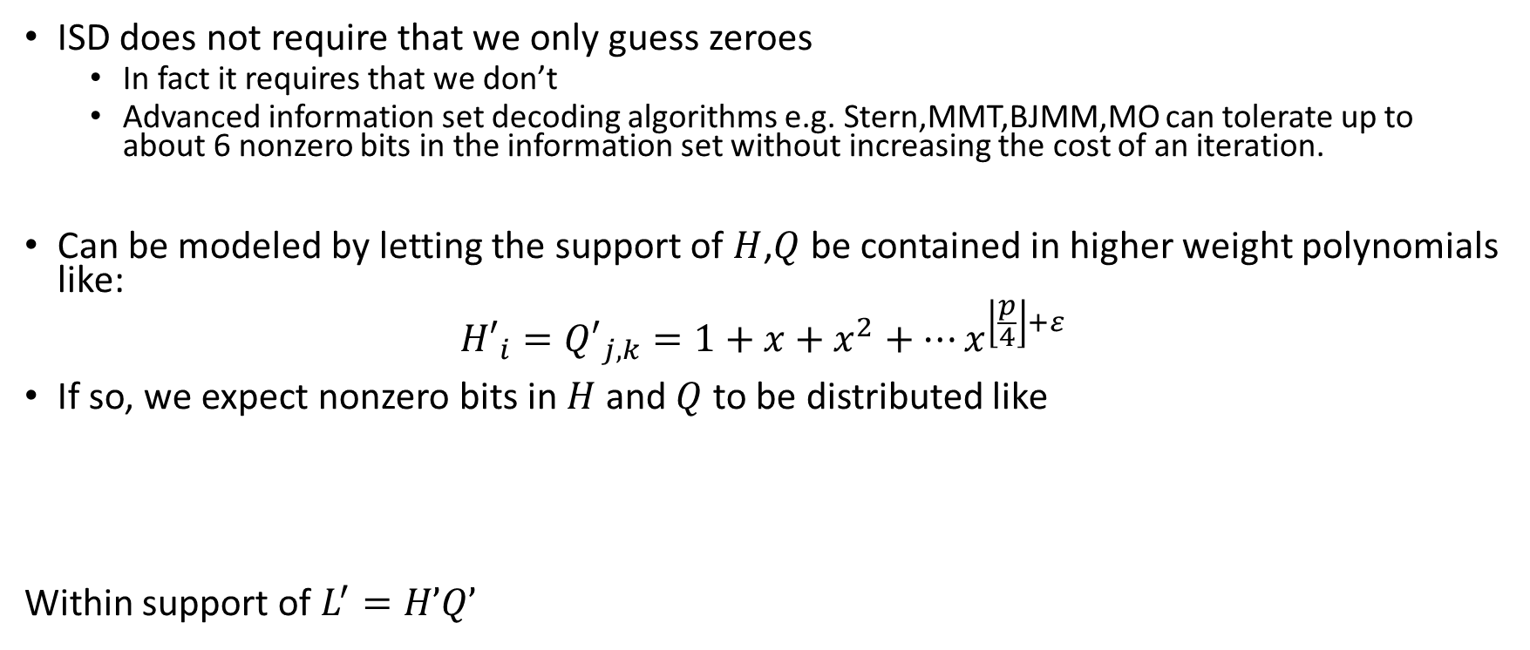
Advanced information set decoding
ISD does not require that we only guess zeroes
  In fact it requires that we don’t
  Advanced information set decoding algorithms e.g. Stern,MMT,BJMM,MO can tolerate up to about 6 nonzero bits in the information set without increasing the cost of an iteration.
Can be modeled by letting the support of $H$,$Q$ be contained in higher weight polynomials like:
$${H′}_{i}={Q′}_{j,k}=1+x+x^{2}+…x^{\left\lfloor \frac{p}{4}\right\rfloor +ε}$$
If so, we expect nonzero bits in $H$ and $Q$ to be distributed like
Within support of $L^{′}=H’Q’$

Slide 14
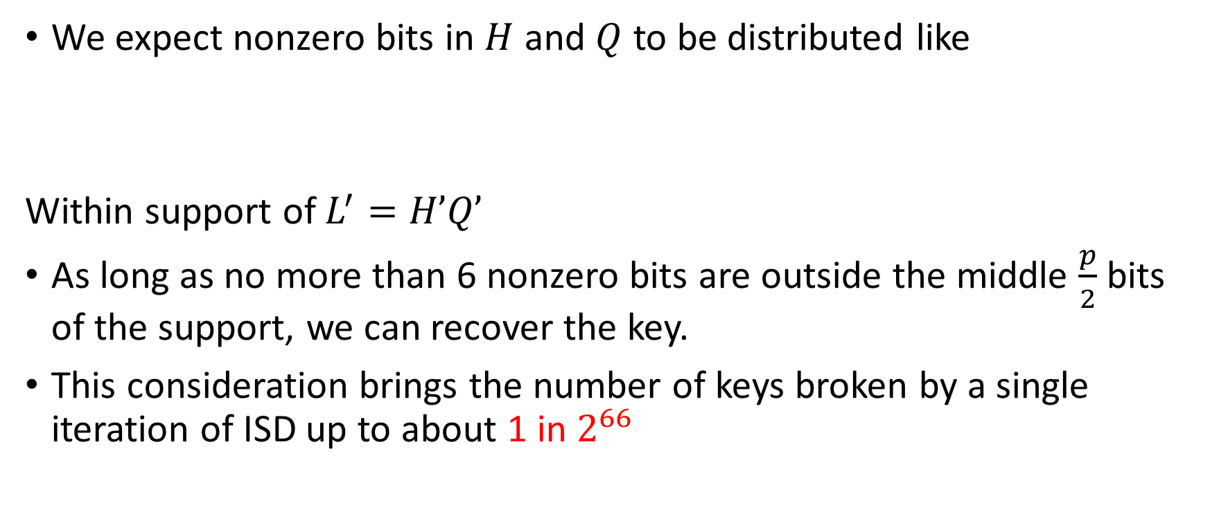
Advanced information set decoding cont.
We expect nonzero bits in $H$ and $Q$ to be distributed like
Within support of $L^{′}=H’Q’$
As long as no more than 6 nonzero bits are outside the middle $\frac{p}{2}$ bits of the support, we can recover the key.
This consideration brings the number of keys broken by a single iteration of ISD up to about 1 in $2^{66}$

Slide 15

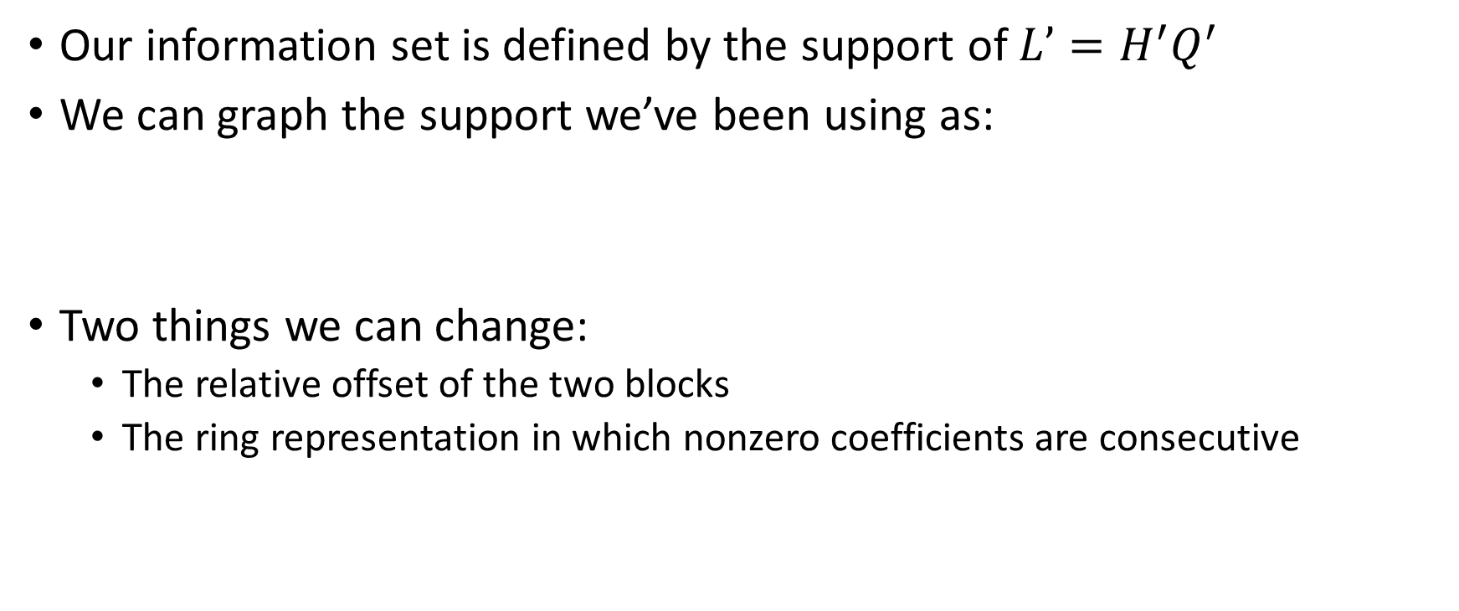

How many equally good (and independent) information sets?
Our information set is defined by the support of $L’=H^{′}Q^{′}$
We can graph the support we’ve been using as:
Two things we can change:
  The relative offset of the two blocks
  The ring representation in which nonzero coefficients are consecutive
$${L′}_{0}$$
$${L′}_{1}$$

Slide 16
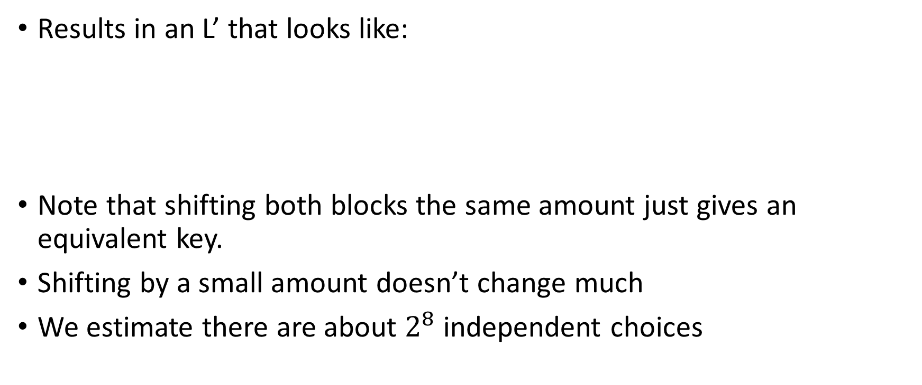
Changing the offset
Results in an L’ that looks like:
Note that shifting both blocks the same amount just gives an equivalent key.
Shifting by a small amount doesn’t change much
We estimate there are about $2^{8}$ independent choices
$${L′}_{0}$$
$${L′}_{1}$$

Slide 17
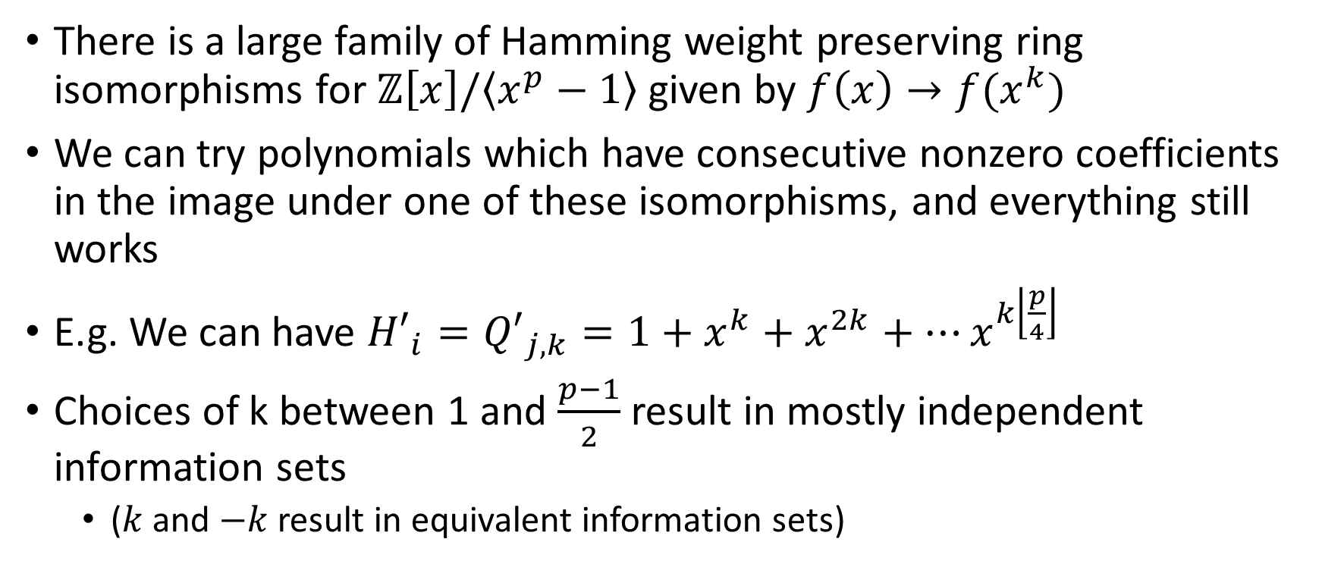
Ring representations
There is a large family of Hamming weight preserving ring isomorphisms for $ℤ\left[x\right]/\left\langle x^{p}−1\right\rangle$ given by $f\left(x\right)→f(x^{k})$
We can try polynomials which have consecutive nonzero coefficients in the image under one of these isomorphisms, and everything still works
E.g. We can have ${H′}_{i}={Q′}_{j,k}=1+x^{k}+x^{2k}+…x^{k\left\lfloor \frac{p}{4}\right\rfloor }$
Choices of k between 1 and $\frac{p−1}{2}$ result in mostly independent information sets
  ($k$ and $−k$ result in equivalent information sets)

Slide 18
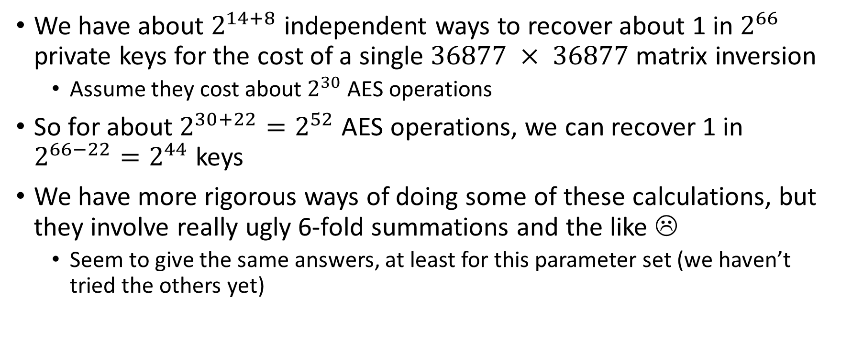
Putting it all together
We have about $2^{14+8}$ independent ways to recover about 1 in $2^{66}$ private keys for the cost of a single $36877 × 36877$matrix inversion
  Assume they cost about $2^{30}$ AES operations
So for about $2^{30+22}=2^{52}$ AES operations, we can recover 1 in $2^{66−22}=2^{44}$ keys
We have more rigorous ways of doing some of these calculations, but they involve really ugly 6-fold summations and the like ☹
  Seem to give the same answers, at least for this parameter set (we haven’t tried the others yet)

Slide 19
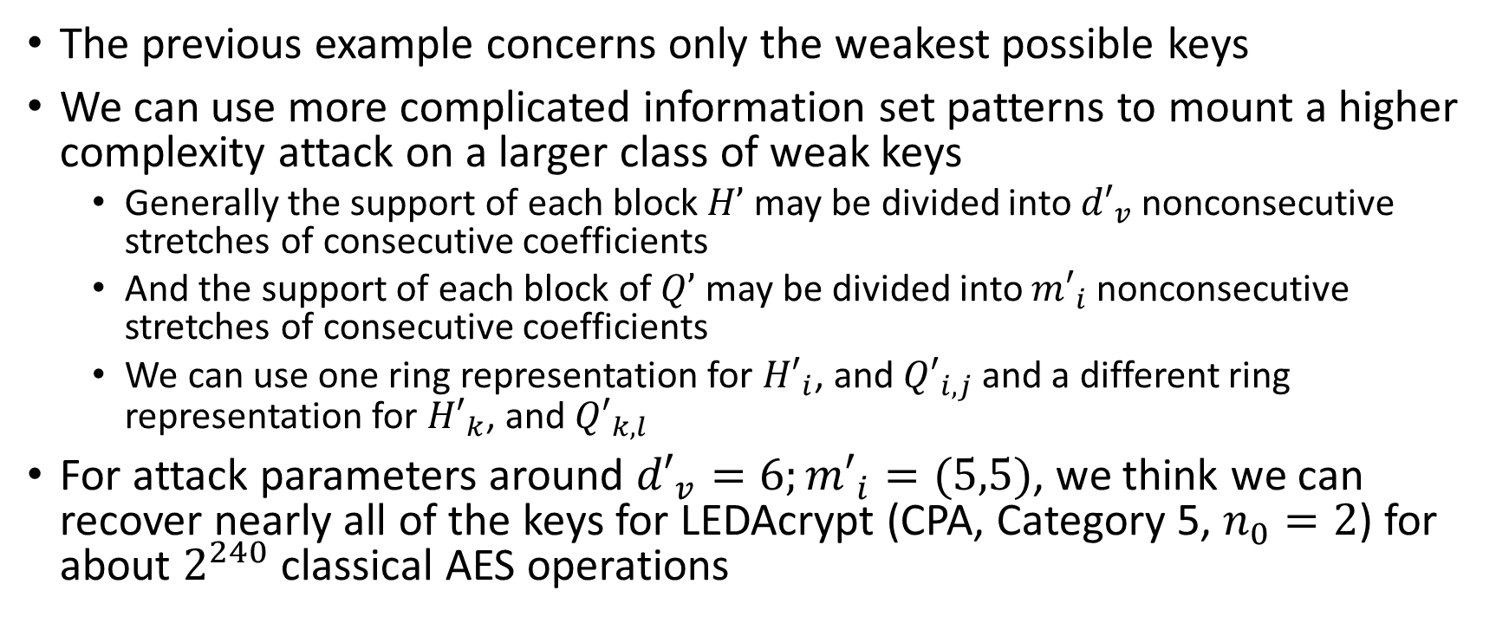
Less weak keys
The previous example concerns only the weakest possible keys
We can use more complicated information set patterns to mount a higher complexity attack on a larger class of weak keys
  Generally the support of each block $H’$may be divided into ${d′}_{v}$ nonconsecutive stretches of consecutive coefficients
  And the support of each block of $Q’$ may be divided into ${m′}_{i}$ nonconsecutive stretches of consecutive coefficients
  We can use one ring representation for ${H′}_{i}$, and ${Q′}_{i,j}$ and a different ring representation for ${H′}_{k}$, and ${Q′}_{k,l}$
For attack parameters around ${d′}_{v}=6;{m′}_{i}=(5,5)$, we think we can recover nearly all of the keys for LEDAcrypt (CPA, Category 5, $n_{0}=2$) for about $2^{240}$ classical AES operations

Slide 20
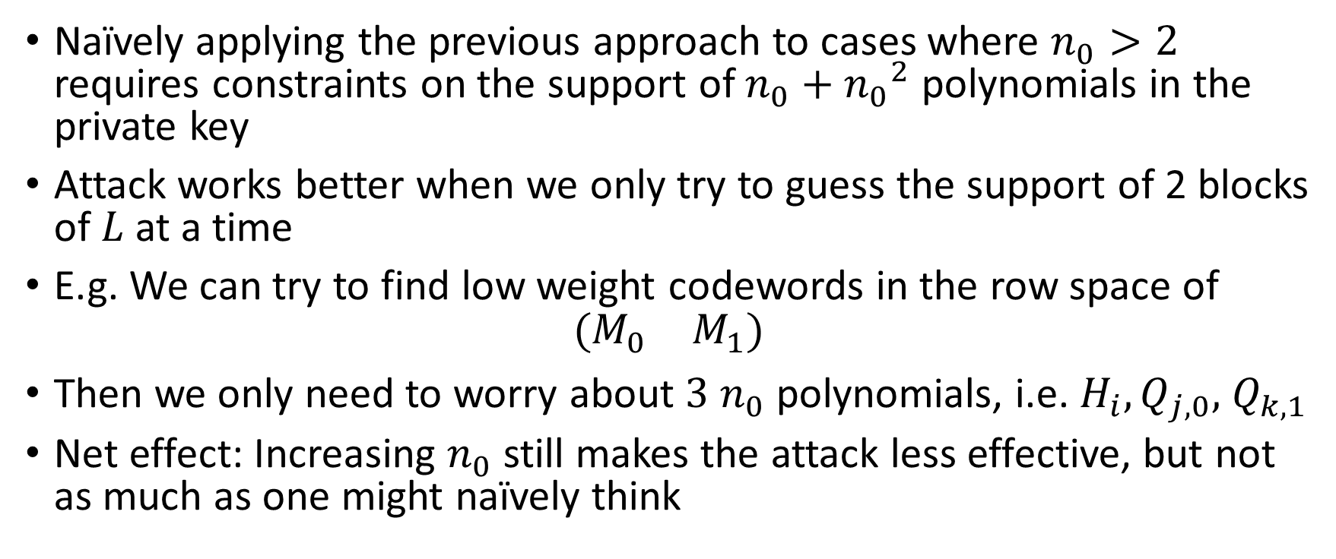

Considerations for $n_{0}>2$
Naïvely applying the previous approach to cases where $n_{0}>2$ requires constraints on the support of $n_{0}+{n_{0}}^{2}$ polynomials in the private key
Attack works better when we only try to guess the support of 2 blocks of $L$ at a time
E.g. We can try to find low weight codewords in the row space of
$$\left(\begin{matrix}M_{0} & M_{1}\end{matrix}\right)$$
Then we only need to worry about $3$ $n_{0}$ polynomials, i.e. $H_{i},Q_{j,0},$ $Q_{k,1}$
Net effect: Increasing $n_{0}$ still makes the attack less effective, but not as much as one might naïvely think

Slide 21
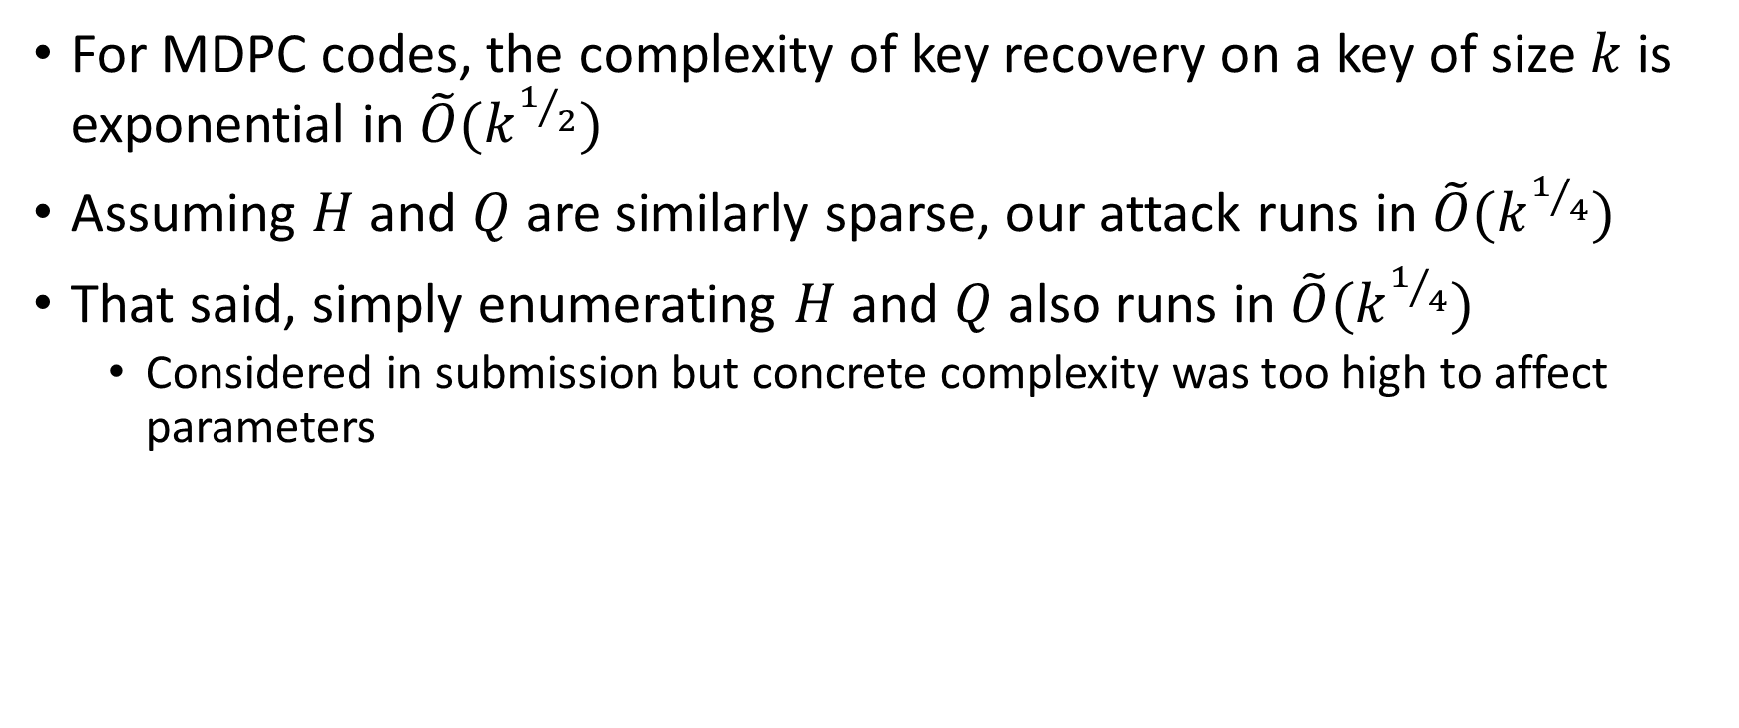
Asymptotics
For MDPC codes, the complexity of key recovery on a key of size $k$ is exponential in $\tilde{O}(k^{1/2})$
Assuming $H$ and $Q$ are similarly sparse, our attack runs in $\tilde{O}(k^{1/4})$
That said, simply enumerating $H$ and $Q$ also runs in $\tilde{O}(k^{1/4})$
  Considered in submission but concrete complexity was too high to affect parameters

Slide 22
Conclusion
Our attack shows that LEDAcrypt’s product structure is a security problem not just asymptotically, but concretely
From a practical perspective, the weak key attacks are probably most worrying
  And they are present in all parameter sets
For some parameter sets, our attack is significantly better than standard information set decoding even on non-weak keys
More work needs to be done to fully quantify the impact and tradeoffs for this attack
  We plan to do this work fairly soon

